Slide 1
Simply EKS Deployment with Terraform: Unlock the Power of Automation
Madhu Kumar Yeluri, Principal Cloud Architect

Slide 2

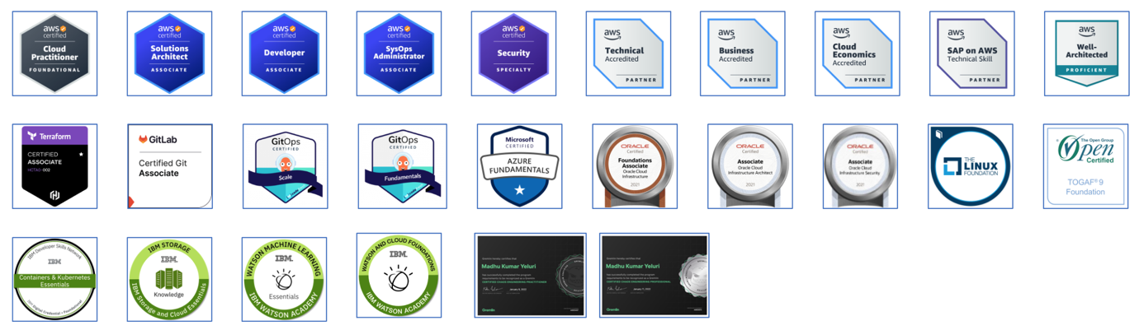

About the Speaker
Madhu is an accomplished Principal Cloud Architect and DevSecOps Consultant with more than two decades of experience in the IT industry across different parts of the world.

Slide 3
Provisioning an EKS Cluster (AWS)

Slide 4
Provisioning an EKS Cluster (AWS)
AWS's Elastic Kubernetes Service (EKS) is a managed service that lets you deploy, manage, and scale containerized applications on Kubernetes.
In this tutorial, you will deploy an EKS cluster using Terraform. Then, you will configure kubectl using Terraform output and verify that your cluster is ready to use.
https://github.com/cloudgeek7/learn-terraform-provision-eks-cluster

Slide 5
Warning
AWS EKS clusters cost $0.10 per hour, so you may incur charges by running this tutorial. The cost should be a few dollars at most, but be sure to delete your infrastructure promptly to avoid additional charges. We are not responsible for any charges you may incur.

Slide 6
Why deploy with Terraform?
While you could use the built-in AWS provisioning processes (UI, CLI, CloudFormation) for EKS clusters, Terraform provides you with several benefits:
Unified Workflow - If you already use Terraform to deploy AWS infrastructure, you can use the same workflow to deploy both EKS clusters and applications into those clusters.
Full Lifecycle Management - Terraform creates, updates, and deletes tracked resources without requiring you to inspect an API to identify those resources.
Graph of Relationships - Terraform determines and observes dependencies between resources. For example, if an AWS Kubernetes cluster needs a specific VPC and subnet configurations, Terraform will not attempt to create the cluster if it fails to provision the VPC and subnet first.

Slide 7
Prerequisites
This tutorial assumes that you are familiar with the Terraform workflow.
For this tutorial, you will need:
Terraform v1.3+ installed locally.
an AWS account
the AWS CLI v2.7.0/v1.24.0 or newer, installed and configured
AWS IAM Authenticator
kubectl v1.24.0 or newer

Slide 8
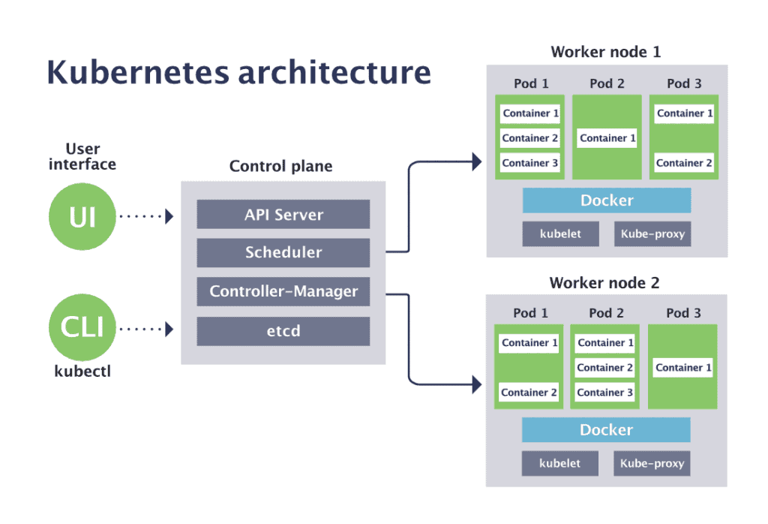
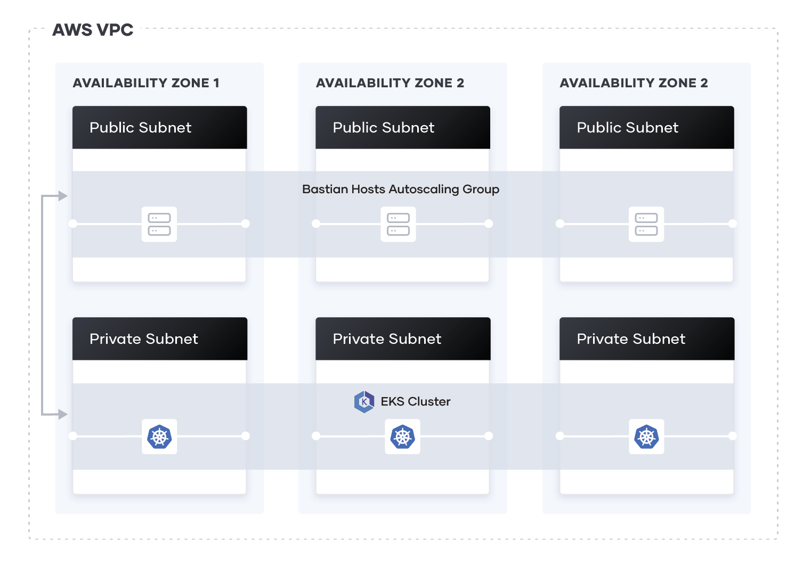
EKS Cluster Architecture – Example
https://www.cncf.io/blog/2019/08/19/how-kubernetes-works
https://developer.hashicorp.com/terraform/tutorials/kubernetes/eks

Slide 9
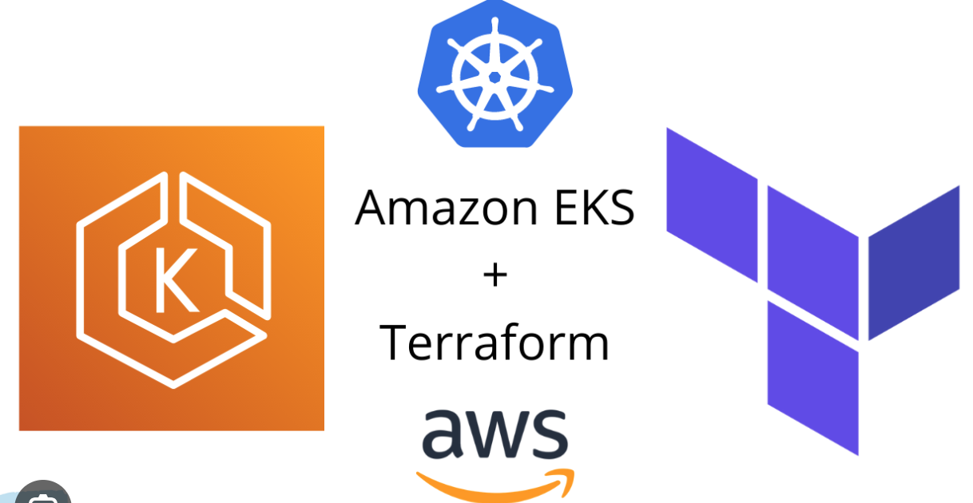


DEMO TIME

Slide 10



